Slide 1
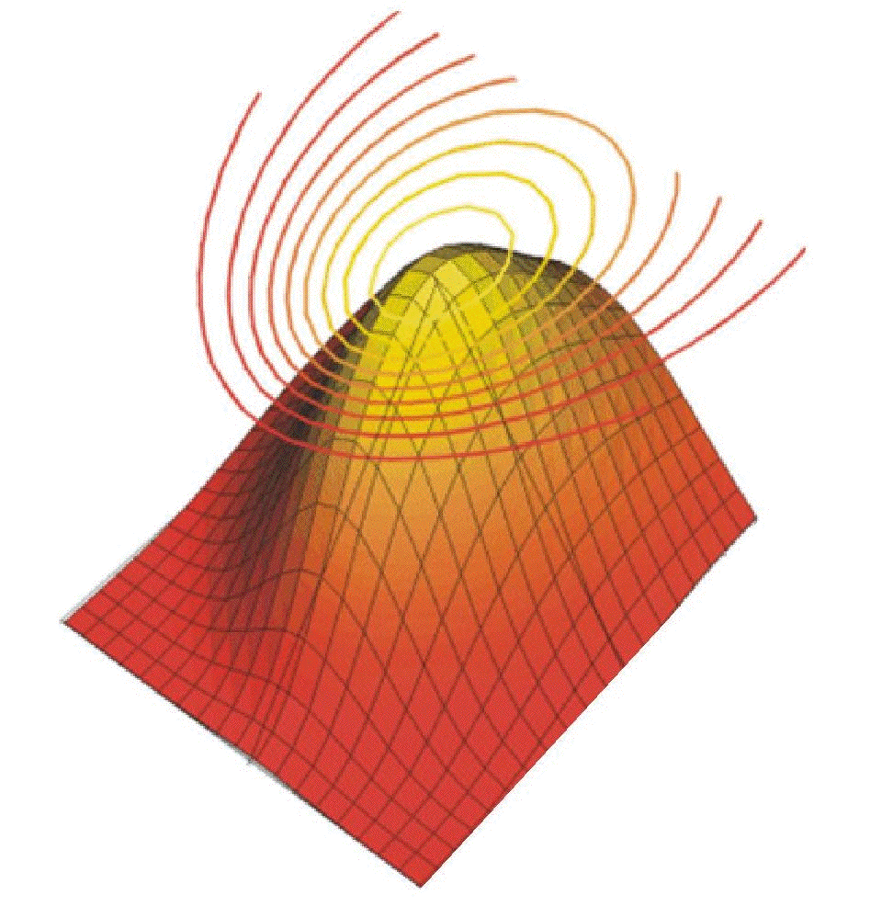
Statistics: Tools and Techniques
COM527
Statistical Analysis Techniques

Slide 2
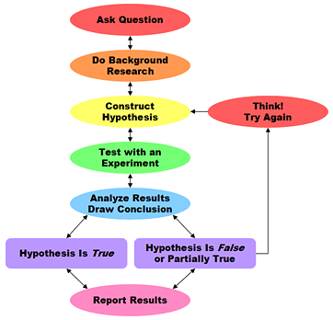
Research Methods
Un-biased
Repeatable
Objective
Transparent

Slide 3

What constitutes evidence?
Collection and analysis of data collected that indicates a result, in which we have confidence beyond reasonable doubt

Slide 4

Statistical Analysis
Discover patterns & trends in data
  Often by sampling a population
  Larger sample = more representative
  Compare data sets & find relationships
Computer-based tools
  MS Excel, Matlab, MathCAD,
  Maple, SPSS, etc.
  Learn how to use the stats feature
  of at least one

Slide 5
Research Data Types
Nominal
  Non-numeric data but can count occurrences
  e.g.: Nationality, date of birth, routing protocol used,…
Ordinal
  Related / rank ordering of data but difference not important (size: S,M,L,XL)
Interval
  Fixed distance between steps (length, time, cost)
Ratio
  Similar to interval but 0 is significant (height, weight)

Slide 6
Quantitative Investigation
State a hypothesis based on a “causal” relationship between modes/configurations
Selection of an independent variable(s) (the cause) and a dependent variable(s) (the effect) in the relationship
Design of a controlled experiment or survey
Data collection
Data analysis using statistical methods
Provide evidence / rationale that proves or disproves the hypothesis

Slide 7
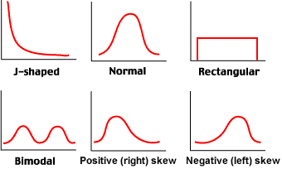
Samples & Distribution
A population is usually too large to quantify
  Leads us to sample a population
Frequency distribution indicates central tendencies and spread of values within a sample (vector)
  Histogram measures frequency of value occurrence

Slide 8
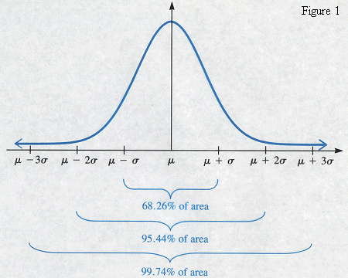
Normal Distribution

Slide 9
Quantitative Reliability
Sampling a population
  Sample size should be representative of the population distribution
    Otherwise see exception fallacy
  Larger sample=more representative
Practicalities
  Time & financial costs
  Dimensions of data per sample
  Size of population

Slide 10
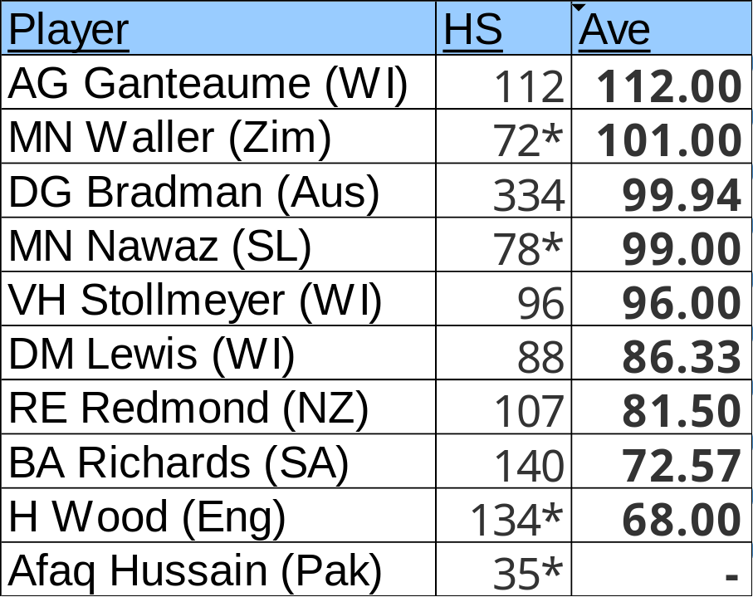

Sample Size Importance
Who is the better test match batsman based on average?

Slide 11
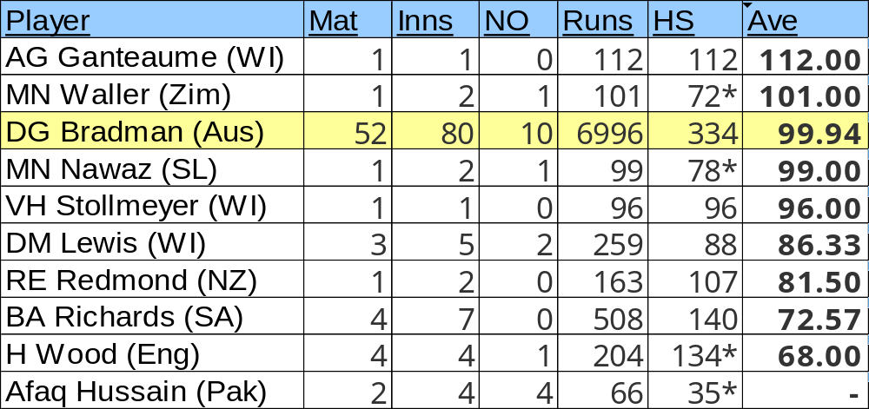
Sample Size Importance
More samples (in this case innings) indicates consistency & brings reliability

Slide 12
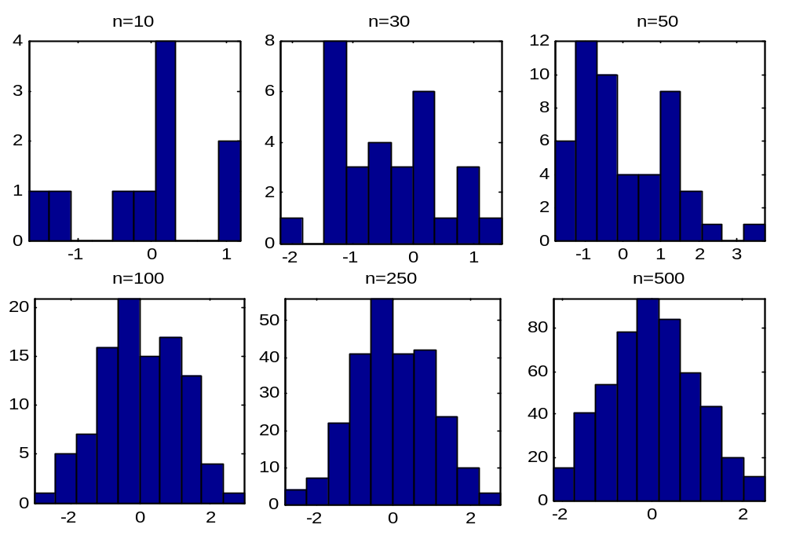
Sample Size Importance
Larger sample = more representative
Random samples from an ideal normal distribution:

Slide 13
Sampling
Who is the population?
How will samples be obtained?
  Selected by researcher?
  Selected by participant?
  Randomly?
What size of sample will be used?
  Justification
  Is the sample representative?
How many sample groups?
  Will there be groups at all? (Usually a good idea)

Slide 14
Sampling
Everybody that the research is targeted to be about
Population
The subset of the population that actually participates in the research
Sample

Slide 15
Sampling
Probability sampling
  Simple random sampling
  Systematic sampling
  Stratified sampling
Non-probability sampling
  Convenience sampling
  Quota sampling
Have some element of random selection
Susceptible to biased selection

Slide 16
Sampling Procedures
Assuming a population of N participants:
Random sampling
  Chance of being selected = 1/N
Systematic sampling
  Select every z^{th} person
Stratified sampling
  Identify existing population groups
  Random sample (1/N from each group)

Slide 17
Sampling Procedures
Convenience Sampling
  Select participants who are easily obtainable
Quota Sampling
  Identify existing population groups
  Take from each group until target number reached

Slide 18
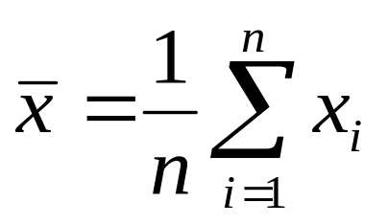
The 3 ‘average’ Ms
Mean
  ‘Average’: Sum of all samples divided by number of samples
Median
  Middle value in a sample set that splits the distribution
  Mean of two middle values in even number set
    {1,3,10}; Median=3
    {1,3,5,7,9,10}; Median=6 (mean of two middle values)
Mode
  Most occurring actual data value in a sample set
    {4,3,7,3,6,7,3,3}; Mode=3
    {2,6,2,6,9}; Mode=2 & 6 (bi-modal)

Slide 19
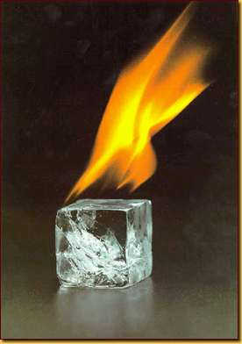
The limitation of means…
If a statistician’s hair were on fire and their feet were frostbitten they would say that, on average, they feel “fine”!

Slide 20
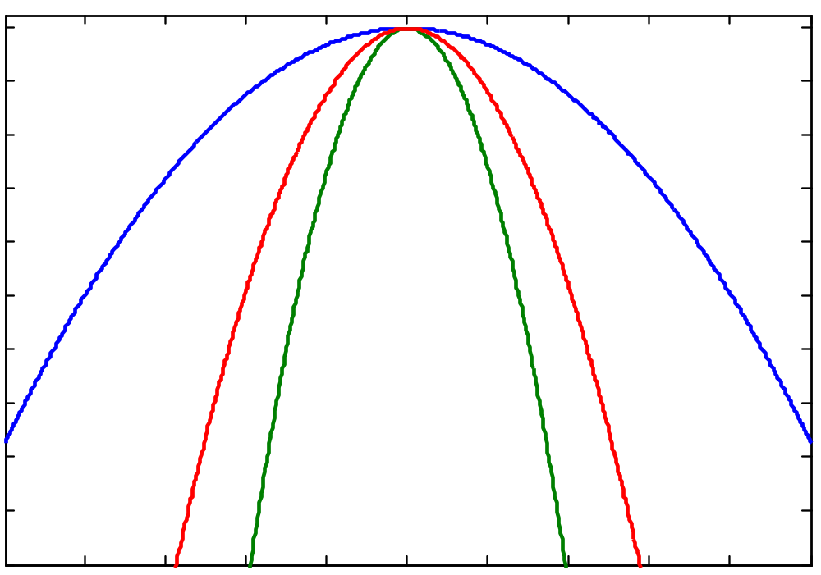
The limitation of means…
What is the difference between these distributions?
  The mean?
  The mode?
  The median?

Slide 21
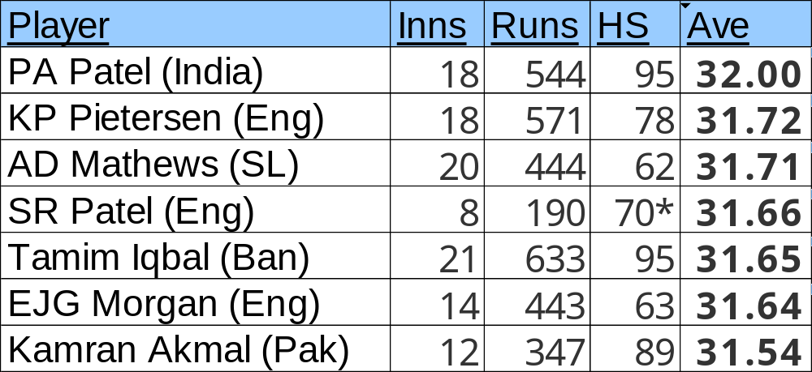
The limitation of means…
You need 31 runs to win the match…
  Based on their mean performance in the last 12 months of ODI matches, which batsman would you ask to bat next?

Slide 22
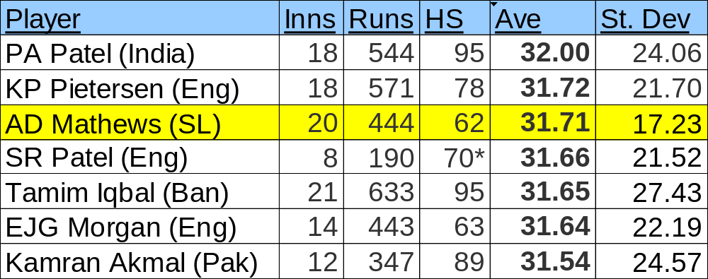
The limitation of means…
You need 31 runs to win the match…
  Based on their mean performance in the last 12 months of ODI matches, which batsman would you ask to bat next?
NB – These standard deviations do not differentiate between not out innings and out innings

Slide 23


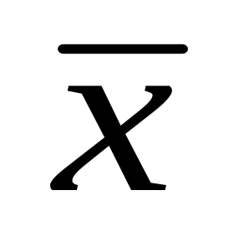
Spread of Values
Provides additional robustness
  Samples may have similar central tendencies but differing dispersion
Range
  Distance between MIN & MAX values
  Range {5,1,3,11,7} = 10

Slide 24
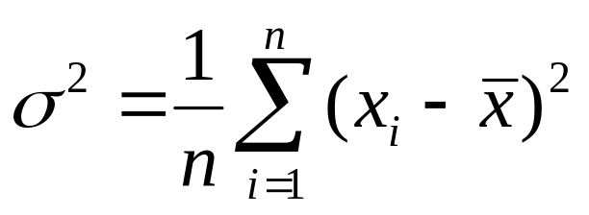
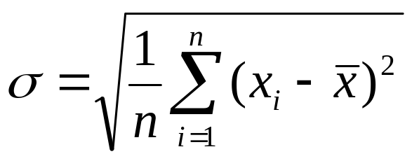
Spread of Values
Variance
  Measurement of spread from mean
Standard deviation (root-mean-square deviation)
  Returns spread from mean in same units as sample

Slide 25
Statistical Estimators
Measures of central tendency and dispersion are key in statistics
When choosing which to use, consider:
  Sufficiency: a statistic that makes use of all of the data available in a sample
  Un-biased: a statistic from a sample should be representative of the population
  Efficiency: choose the statistic that best represents the population
  Resistance: the statistic that is least influenced by outlying sample data

Slide 26
Comparing Variation stats
Measuring variation/deviation between groups is a common statistical analysis
But the magnitude of the mean can contribute to the size of the deviation
  Large means mean large deviations more likely
The test or test scale may also vary between sample groups, meaning substantial differences in variation possible
  e.g. measuring on a 5-point scale or a 15-point scale

Slide 27
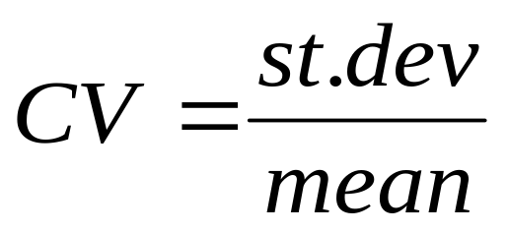
Coefficient of Variation
To counter this, we scale the standard deviation by the magnitude of the mean, producing the coefficient of variation (CV)
This produces a normalised measure of deviation between two sample sets
Often represented as a percentage (CV*100)

Slide 28
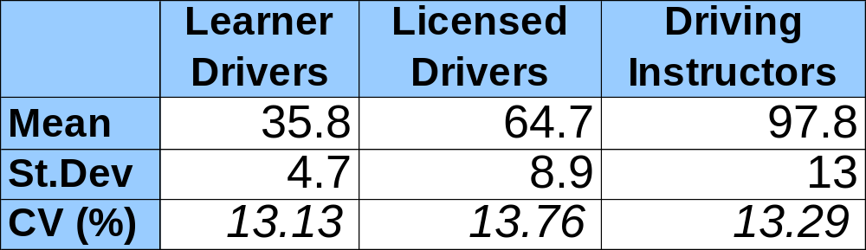
CV Example
Marks out of 100 in driving proficiency test using (say) 20 participants in each group
It seems variability gets worse with experience
  Instructors st.dev more than 175% larger than learners(!)
But, CV values very similar, indicating any difference is a result of the higher means:

Slide 29
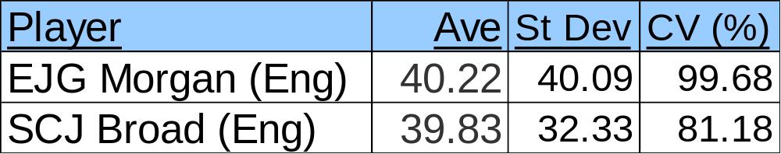
CV Examples
Applying CV to previous examples:
 | Mean | Std |  | CV (%)
N | 27.73 | 9.13 |  | 32.92
O | 24.55 | 9.87 |  | 40.20

Slide 30
Hypothesis Testing
Seek to investigate null or alternative hypotheses
  Null Hypothesis : No difference between variables
  Alternative Hypothesis: Difference between variables
For example:
  H₀: There is no difference in intelligence between penguins & humans
  H₁: There is a difference in intelligence between penguins & humans (penguins are more intelligent)

Slide 31
Aims / Hypotheses
A good hypothesis is testable
  Not provable, in the sense of “shown to be true”
  This is standard scientific practice
  Simply refuting a hypothesis is OK
    but better science will explain why a hypothesis is wrong,
    and (better still) offer an alternative hypothesis
  Remember, we want defined outcomes, not surrogate or cherry-picked ones! http://www.youtube.com/watch?v=JL-SmhFlFoQ

Slide 32
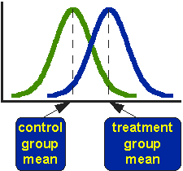

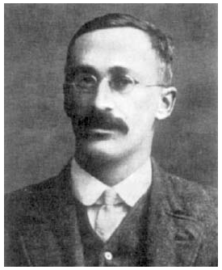
Comparing Results: The T test
The t-test is used to compare sets of results
  Analysis of mean & variance
    Parametric test = population assumed to be normal
Determine if they are from same population
  E.g.- Idealised normal distributions
William Gosset

Slide 33
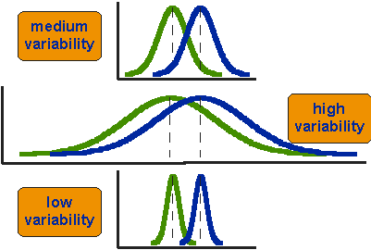
Comparing Results: The T-test
Are these from same distributed population?
  Distance between means is static
    This is why ‘mean-only’ analysis is weak!
  Variance is of interest: overlap

Slide 34
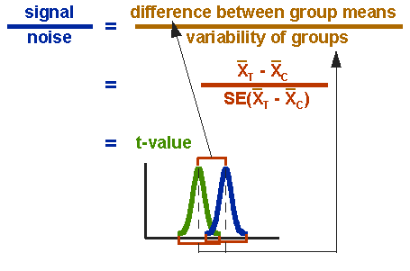

Comparing Results: The T-test
Determine if means are statistically different
T-test formula:
  Where:

Slide 35
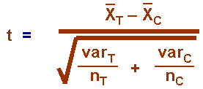
Comparing Results: The T-test
Complete T-test formula:
If t > tabulated value we conclude that the means are significantly different at that level of probability (α)
  Reject the null hypothesis (the sample sets are insignificantly different)
  i.e. the results differ / the ‘change’ has had an impact

Slide 36
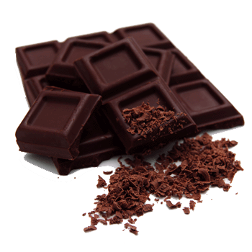
An example Hypothesis Test
H₀: Feeding flagging secretarial students chocolate will not affect their words per minute typing rate (null hypothesis)
H₁: Feeding flagging secretarial students chocolate will affect their words per minute typing rate (alternate hypothesis)

Slide 37
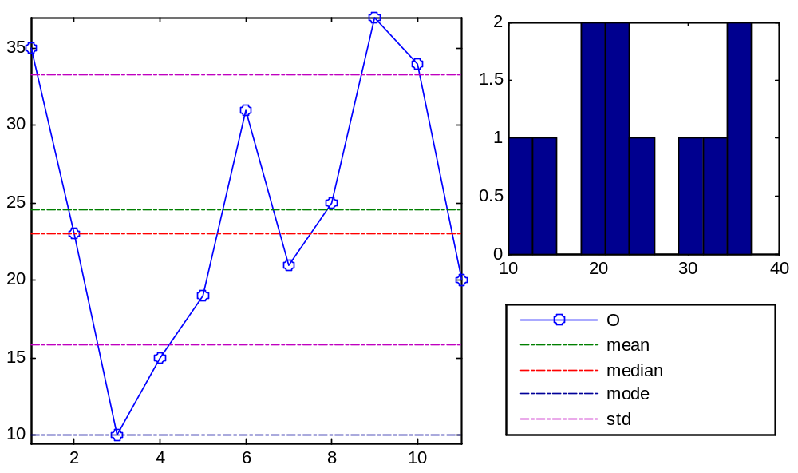
Example: C

Slide 38
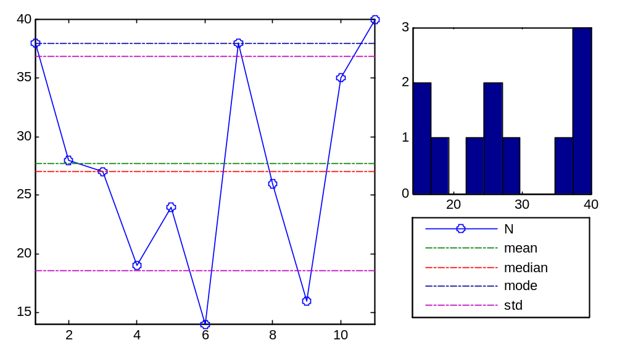
Example: T

Slide 39
Comparing Results: The t-test
  Case of C and T (WPM– chocolate intervention)
    C: 38,28,27,19,24,14,38,26,16,35,40
    T: 35,23,10,15,19,31,21,25,37,34,20
Are the differences significant?
  t=0.8346
 | Mean | Median | Mode |  | Range | Std | Var
C | 27.73 | 27 | 38 |  | 26 | 9.13 | 83.42
T | 24.55 | 23 | 10 |  | 27 | 9.87 | 76.47

Slide 40
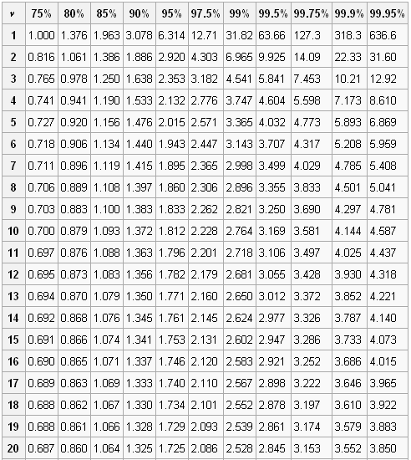
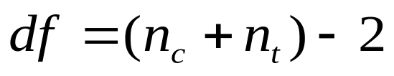
Comparing Results: The T-test
Degrees of freedom
p = probability of error
  In this example
  p=0.05
Table is for 1-tailed test
  Directional difference
    N>O or N<O
  2-tailed test seeks simply
  that a difference exists
    N≠O
    Tests N>O and N<O

Slide 41
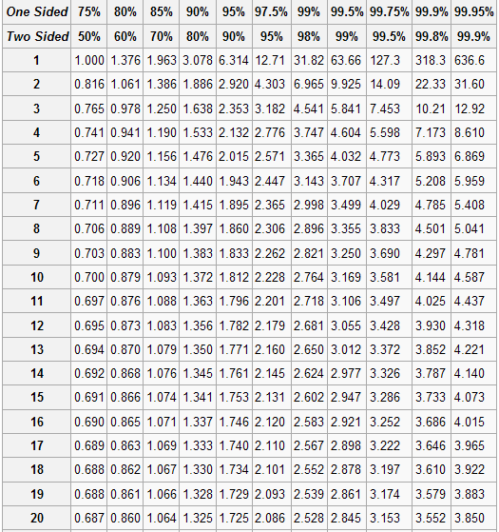
One and Two-Tail Critical Values

Slide 42
Comparing Results: The t-test
Example T-test
  Case of C and T groups
Are the differences significant?
  t(N,O)=t=0.8346, crit=2.086, p<0.05= NO (t<crit)
  We maintain the null hypothesis: H₀
  Mann-Whitney test also maintains null hypothesis
    Mann-Whitney is non-parametric
      Assumes the data has not come from a normal distribution
      This is why histograms are important!
 | Mean | Median | Mode |  | Range | Std | Var
C | 27.73 | 27 | 38 |  | 26 | 9.13 | 83.42
T | 24.55 | 23 | 10 |  | 27 | 9.87 | 76.47

Slide 43
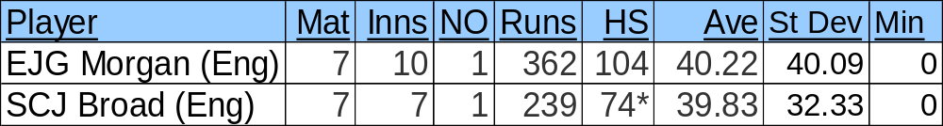
Example
Is there a significant difference between Morgan and Broad in the last year of test matches?

Slide 44
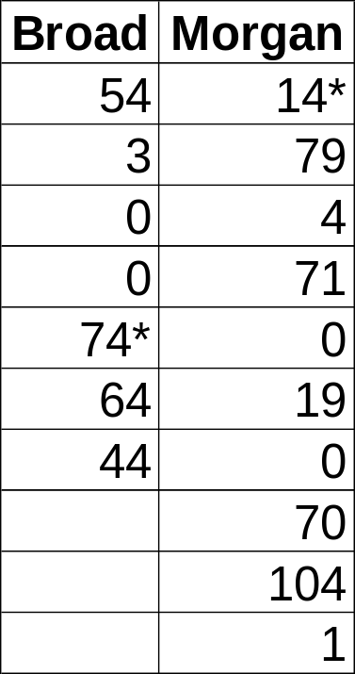
t-Test Cricket Results
t(Broad,Morgan)=-0.11226
df=15
crit(2-tail)=2.131 (95% confidence)
No significant difference between the two players

Slide 45

A brief summary!
http://www.ted.com/talks/ben_goldacre_battling_bad_science.html

Slide 46
Recommended Reading
Social Research Methods: The t-Test
  http://www.socialresearchmethods.net/kb/stat_t.php
Rice University: Student’s t-Test
  http://www.ruf.rice.edu/~bioslabs/tools/stats/ttest.html

